Slide 1
Clash-scores survey
The effect of keeping Hydrogens or not on clash-score
  PDB survey of clash score levels
  Is it performing better when keeping the Hydrogens or not?
Creating an internal clash-score function
  Create an internal clashscore function that work faster and more reliable than the one available today, but give similar scores

Slide 2
Calculating clash score
Wiki pages related to clashscore
https://sites.google.com/a/lbl.gov/phenix-basics/working-notes/clash-score
Using phenix tools
phenix.clashscore model=name.pdb keep_hydrogens=True/False

Slide 3
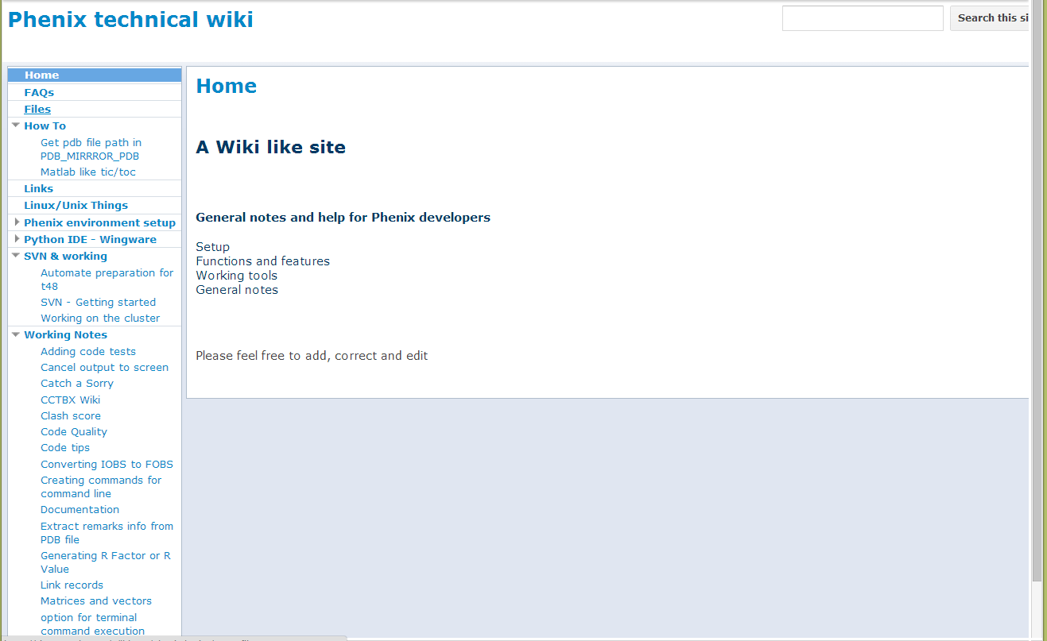

Slide 4
Clash scores - PDB clash score test
Compare all PDB files clashscore
  With Hydrogen (keep_hydrogens=True)
  Without Hydrogen (keep_hydrogens=False)
ELECTRON MICROSCOPE | 688
NEUTRON DIFFRACTION | 66
NMR | 10161
Other | 24
SMALL ANGLE X-RAY SCATTERING | 34
X-RAY DIFFRACTION | 83734
Grand Total | 94707

Slide 5
Combined clashscore

Slide 6
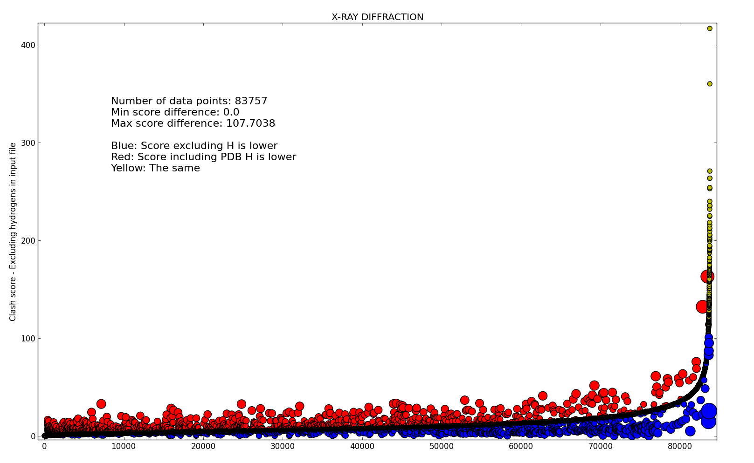
X-RAY DIFFRACTION

Slide 7
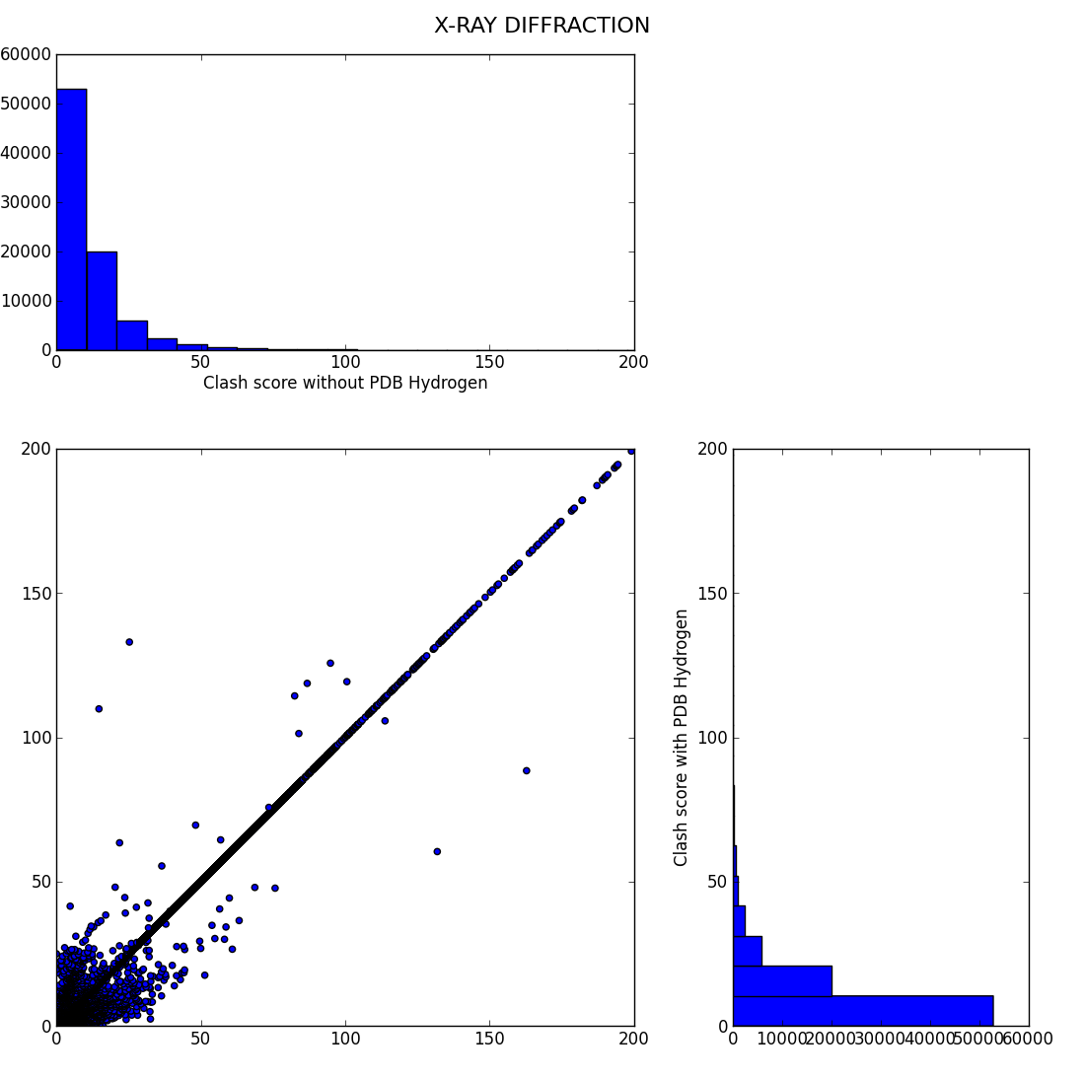
X-RAY DIFFRACTION

Slide 8
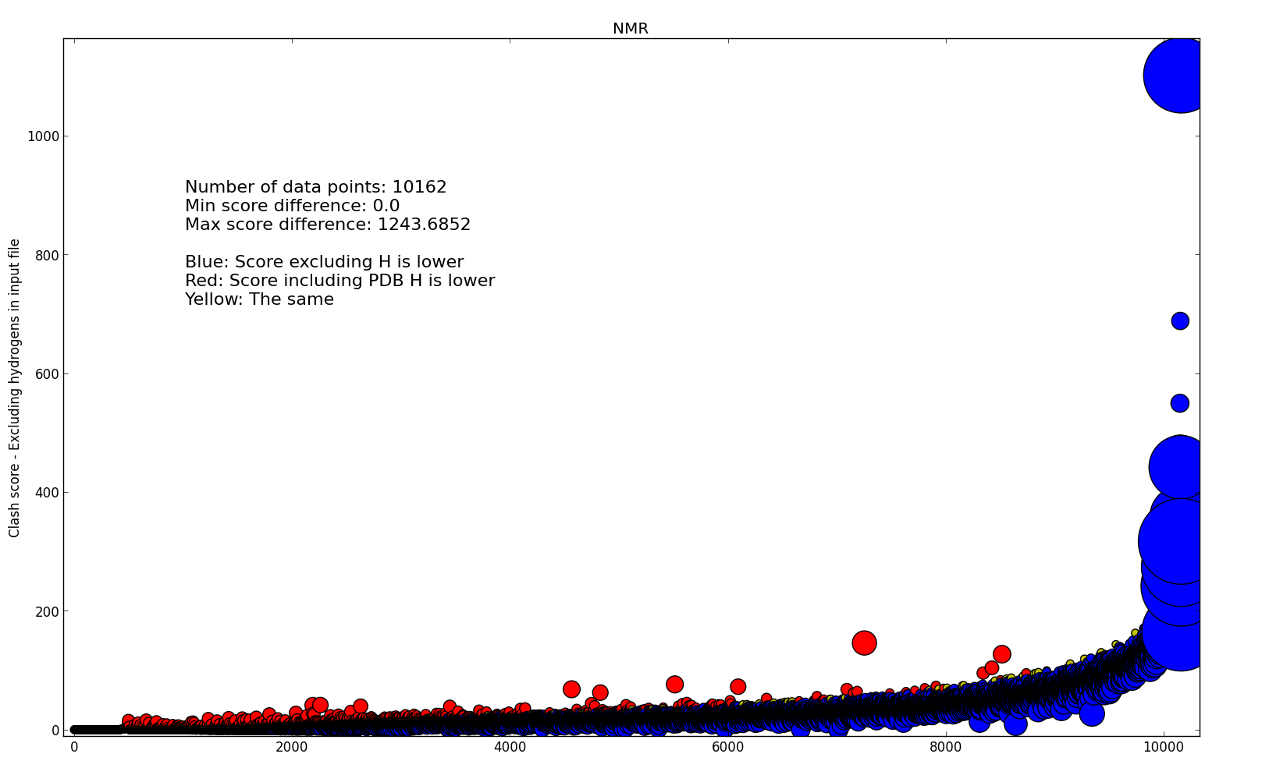
NMR

Slide 9
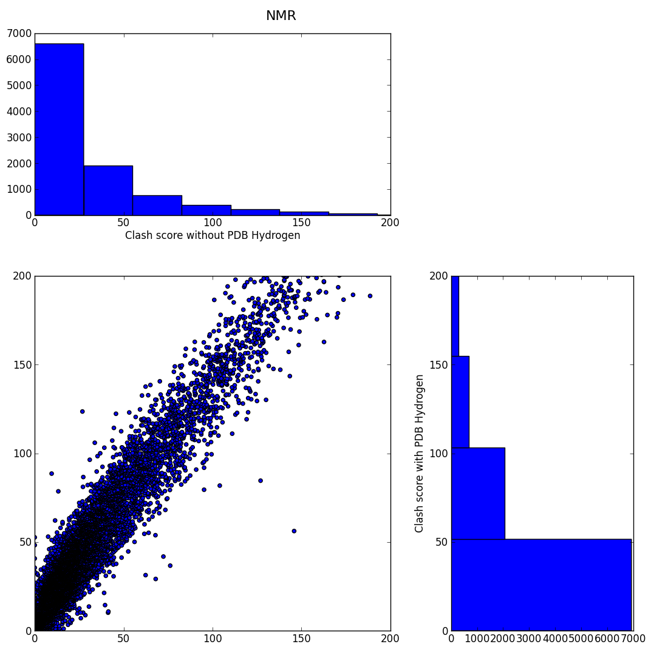
NMR

Slide 10
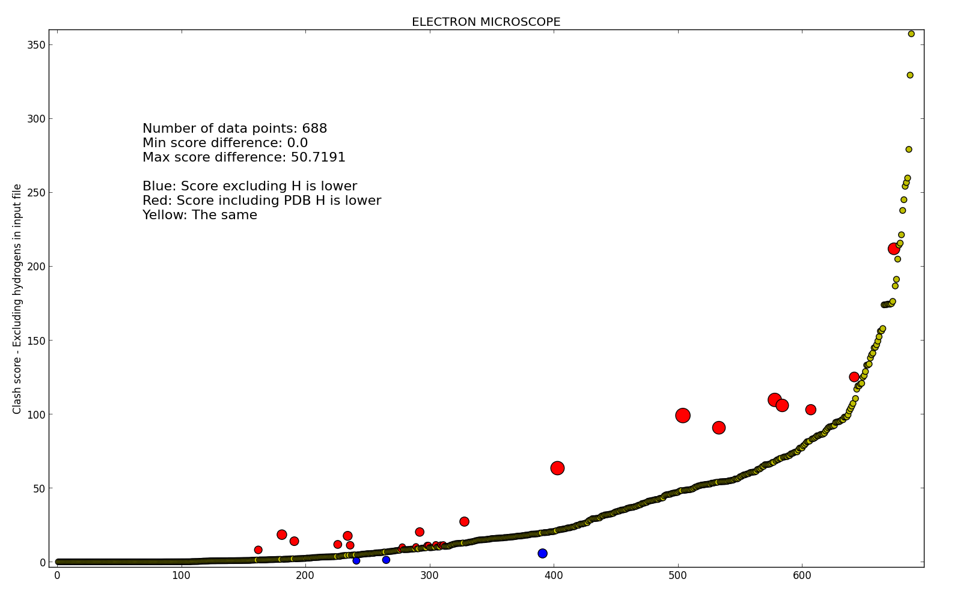
ELECTRON MICROSCOPE

Slide 11
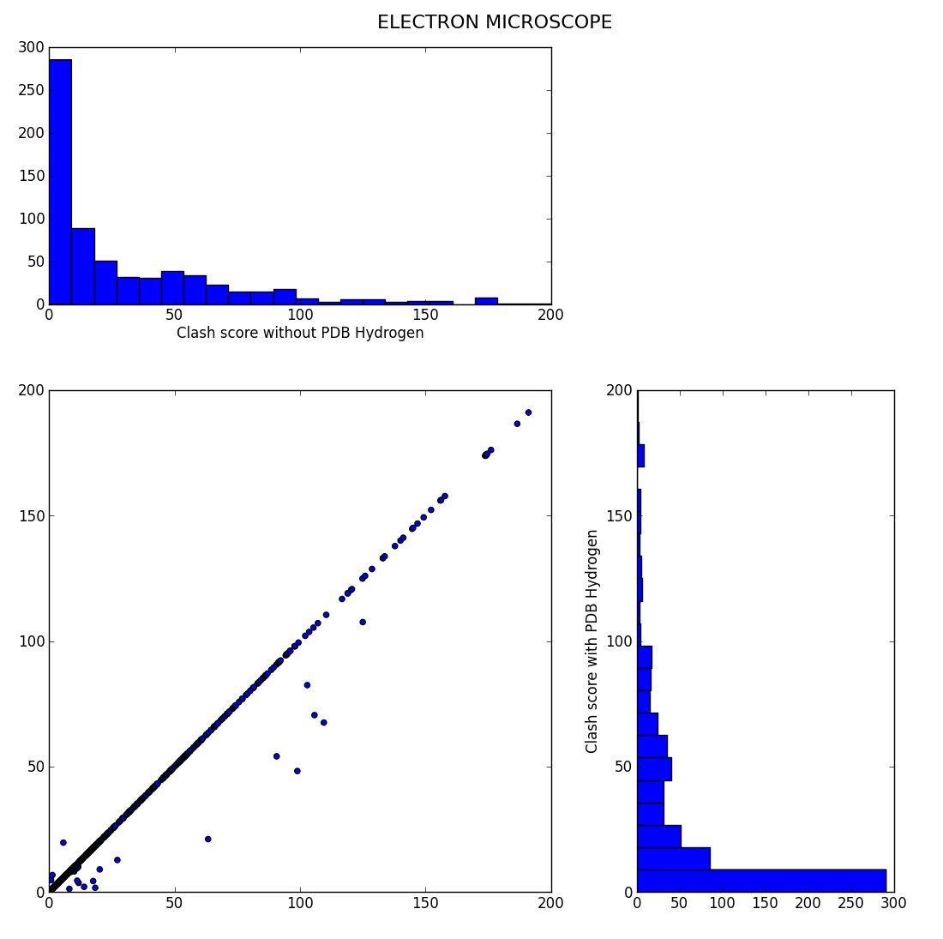
ELECTRON MICROSCOPE

Slide 12
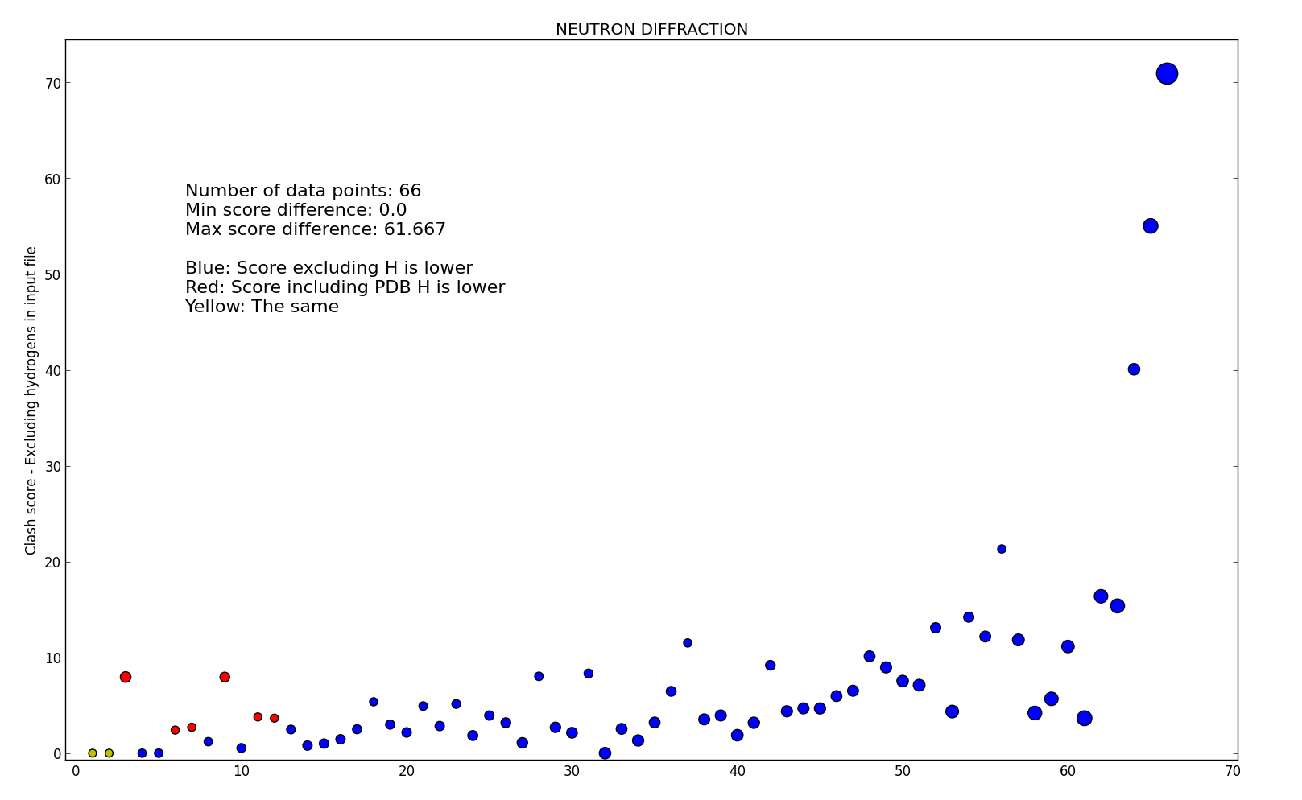
NEUTRON DIFFRACTION

Slide 13
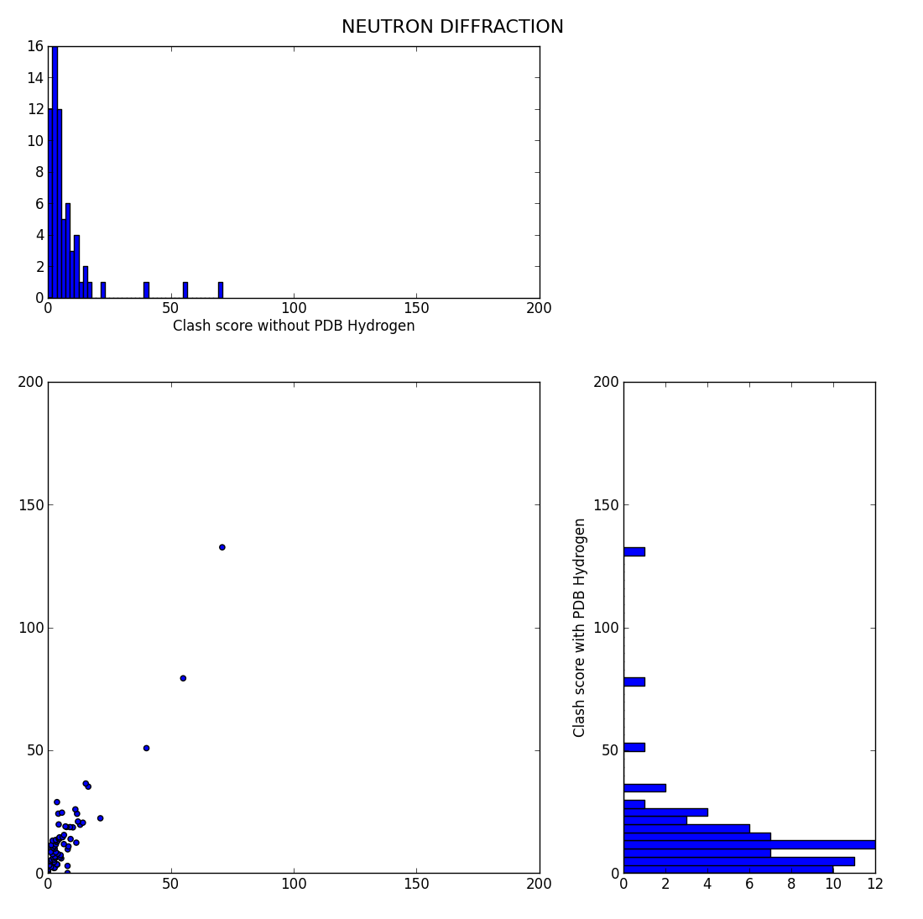
NEUTRON DIFFRACTION

Slide 14
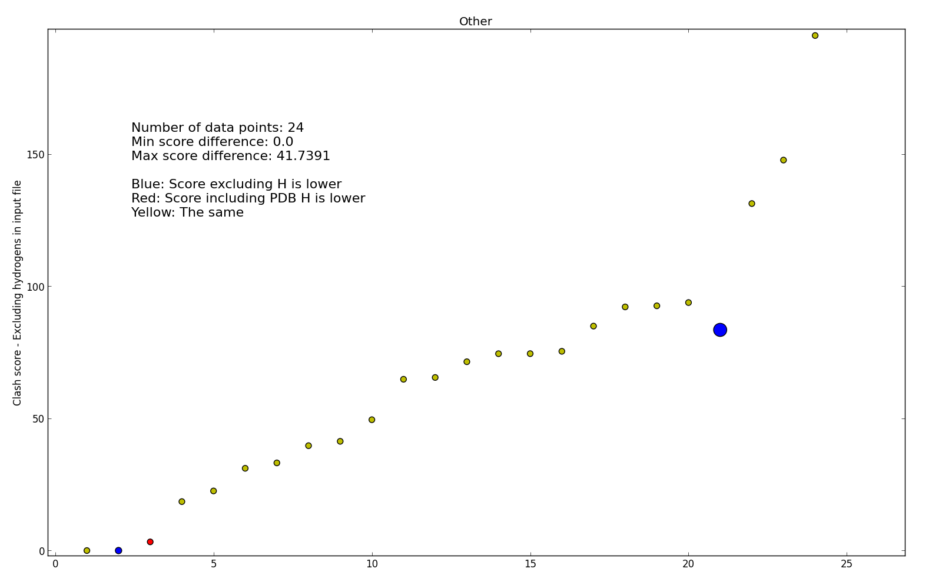
Other

Slide 15
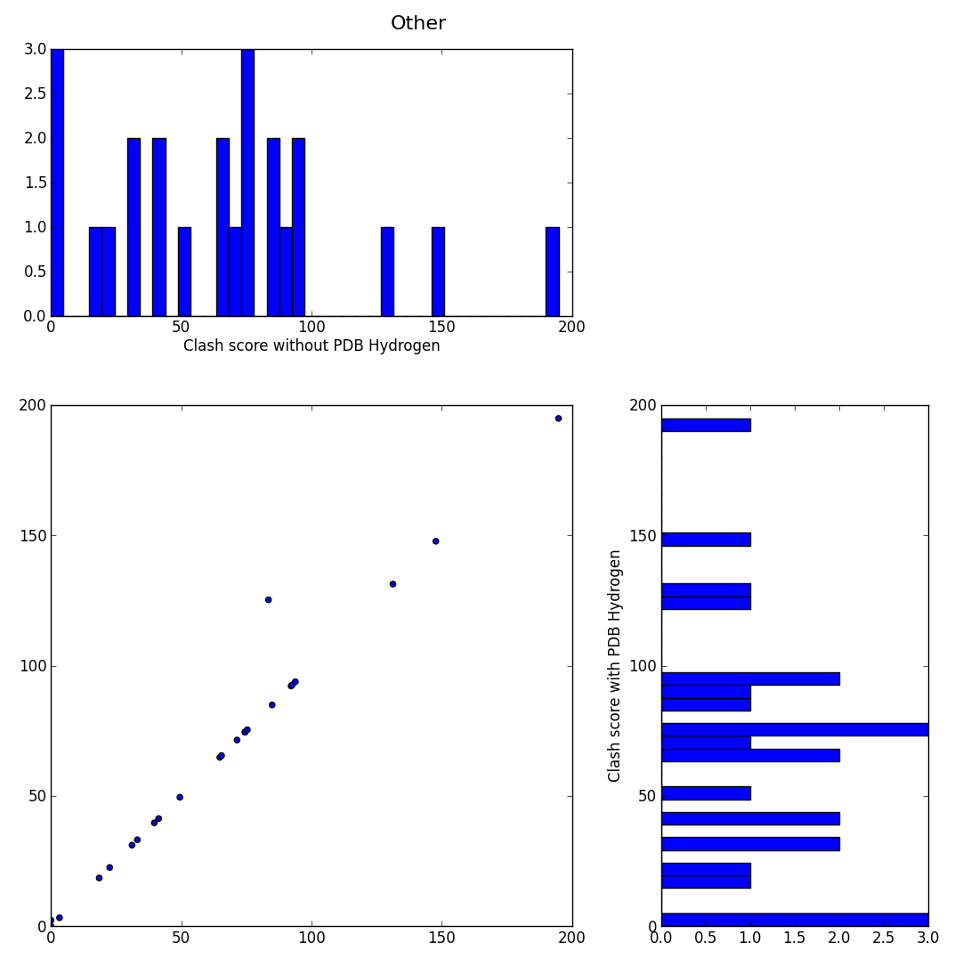
Other

Slide 16
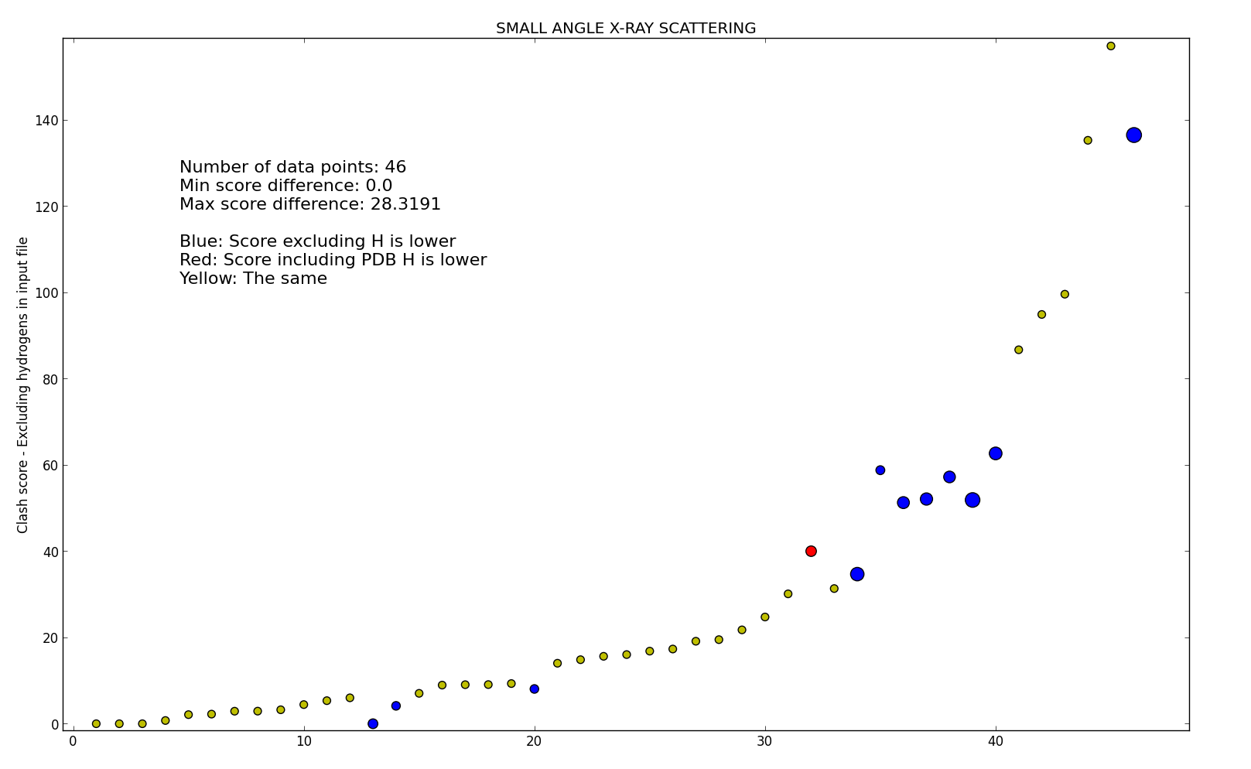
SMALL ANGLE X-RAY SCATTERING

Slide 17
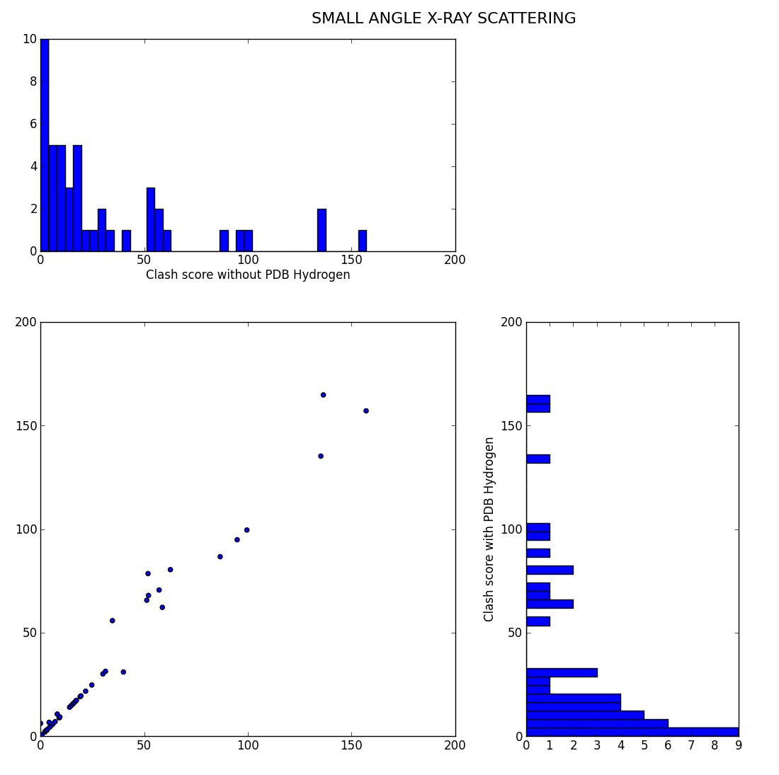
SMALL ANGLE X-RAY SCATTERING

Slide 18
Clash scores - PDB clash score test
From the current classcore test, it is not always clear that there is always benefit in replacing the hydrogen
Consider repeating the test with a internal clashscore

Slide 19
Creating an internal clash-score function
  Create an internal clash-score function
  Want it to:
  Work faster – keep it simple
  Be more reliable than the one available today via REDUCE/PROBE
  Give similar scores
  Example of usage:
  processed_pdb_file = mmtbx.monomer_library.pdb_interpretation.process(…)
  Get the clashing nonbonded atoms list
  clash_list = processed_pdb_file._geometry_restraints_manager._clash_proxies
  Get the clashscore for those pairs
  clash_list = processed_pdb_file._geometry_restraints_manager._clashscore

Slide 20
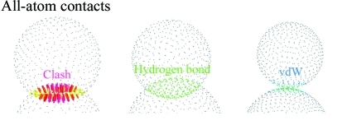
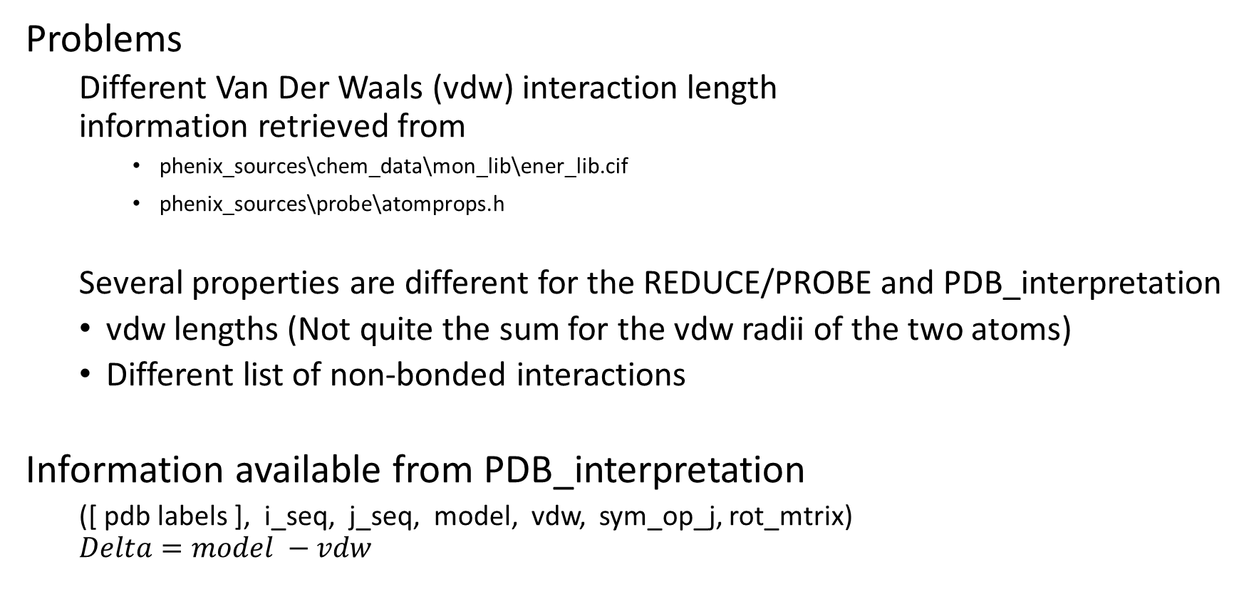
Internal clash-score
Problems
  Different Van Der Waals (vdw) interaction length
  information retrieved from
    phenix_sources\chem_data\mon_lib\ener_lib.cif
    phenix_sources\probe\atomprops.h
  Several properties are different for the REDUCE/PROBE and PDB_interpretation
  vdw lengths (Not quite the sum for the vdw radii of the two atoms)
  Different list of non-bonded interactions
Information available from PDB_interpretation
  ([ pdb labels ], i_seq, j_seq, model, vdw, sym_op_j, rot_mtrix)
  $$Delta=model −vdw$$

Slide 21
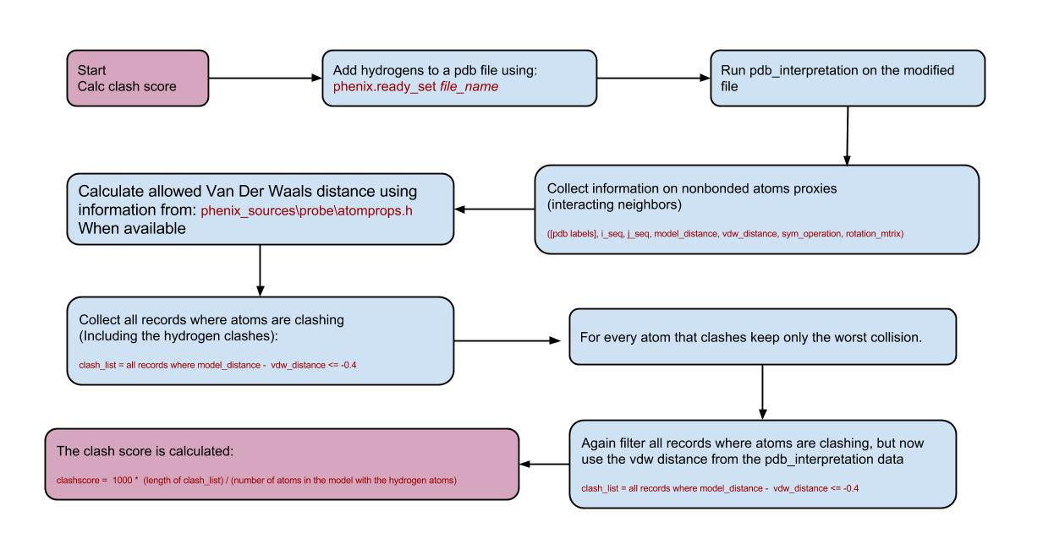
Internal clash-score

Slide 22
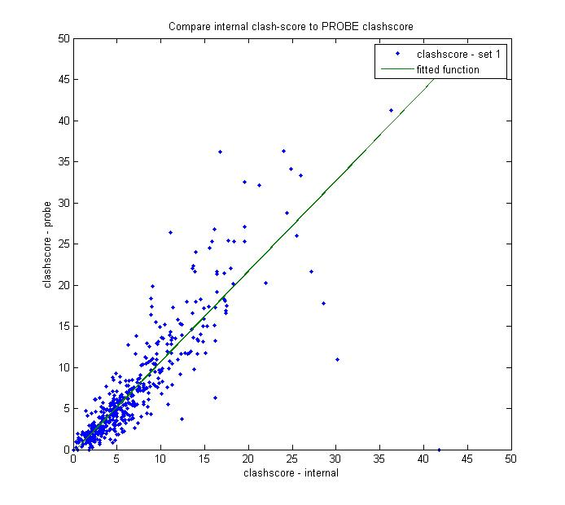
Internal clash-score
~500 PDB files chosen randomly from all files where clashscore < 50
This plot show the results for files where all atoms have atoms have vdw data in ener_lib.cif library
Fitting info
Linear model Poly1:
fittedFun(x) = p1*x + p2
Coefficients (with 95% confidence bounds):
p1 = 1.1 (1.033, 1.166)
p2 = -0.2984 (-0.8936, 0.2969)

Slide 23
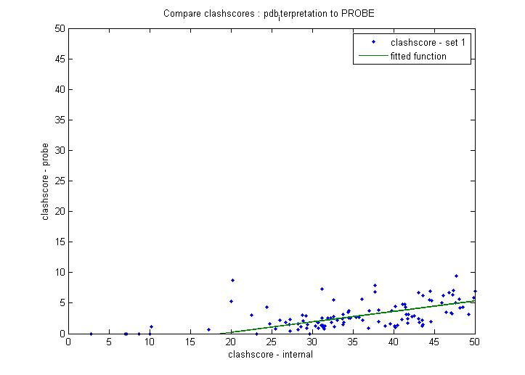
PDB_interpretation clash-score
55 PDB files chosen randomly from all files where clashscore < 50
Linear model Poly1:
fittedFun(x) = p1*x + p2
Coefficients (with 95% confidence bounds):
p1 = 0.171 (0.1542, 0.1879)
p2 = -3.199 (-4.462, -1.936)

Slide 24
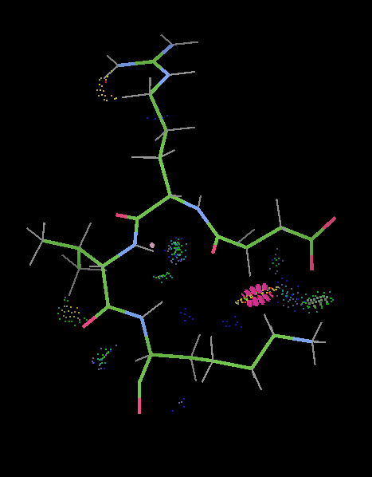
Looking at 101m_h.pbd
Clashes from clashscore:
  A 44 ASP HA A 47 LYS CE -0.121
  A 44 ASP HA A 47 LYS HE2 -0.593
  A 45 ARG HD2 A 45 ARG HH11 -0.339
  A 46 VAL O A 46 VAL HG13 -0.071
  A 46 VAL H A 47 LYS H -0.016

Slide 25
Looking at 101m_h.pbd
Clashes from pdb_interpretation:
HA ASP A 44 HE2 LYS A 47 -0.595
HD2 ARG A 45 HH11 ARG A 45 -0.408
H VAL A 46 H LYS A 47 -0.045
H ARG A 45 HB2 ARG A 45 -0.192
H LYS A 47 HB3 LYS A 47 -0.054
HB2 LYS A 47 HD3 LYS A 47 -0.152
HG2 LYS A 47 HE3 LYS A 47 -0.131
HA ARG A 45 HG2 ARG A 45 -0.088
O ARG A 45 HA VAL A 46 -0.376
HA VAL A 46 HG23 VAL A 46 -0.060
HB3 ARG A 45 HD2 ARG A 45 -0.035
NH1 ARG A 45 HD2 ARG A 45 -0.401
N ARG A 45 H VAL A 46 -0.226
CE LYS A 47 HG2 LYS A 47 -0.083
N VAL A 46 H LYS A 47 -0.211
CG2 VAL A 46 HA VAL A 46 -0.073
  CG ARG A 45 HA ARG A 45 -0.040
  CB LYS A 47 HD3 LYS A 47 -0.036
  C LYS A 47 HG3 LYS A 47 -0.467
  CD ARG A 45 HH11 ARG A 45 -0.457
  O VAL A 46 HG13 VAL A 46 -0.199
  H VAL A 46 N LYS A 47 -0.100
  N ASP A 44 H ARG A 45 -0.087
  O ASP A 44 HA ARG A 45 -0.169
  OD1 ASP A 44 HA ASP A 44 -0.148
  HA ASP A 44 CE LYS A 47 -0.507
  C VAL A 46 HG13 VAL A 46 -0.287
  C VAL A 46 HG12 VAL A 46 -0.282
  C ASP A 44 H VAL A 46 -0.084
  O VAL A 46 HA LYS A 47 -0.002
  O ASP A 44 CA ARG A 45 -0.030
  O ARG A 45 CA VAL A 46 -0.018
  CG ASP A 44 H ASP A 44 -0.022
  CA ASP A 44 HE2 LYS A 47 -0.387
  C VAL A 46 CG1 VAL A 46 -0.144
  C LYS A 47 CG LYS A 47 -0.056
  C ARG A 45 HB VAL A 46 -0.047
  O VAL A 46 C LYS A 47 -0.214
  O VAL A 46 CG1 VAL A 46 -0.394
  O ASP A 44 C ARG A 45 -0.111
  C ASP A 44 N VAL A 46 -0.191
  OD1 ASP A 44 CE LYS A 47 -0.033
  O LYS A 47 CG LYS A 47 -0.014
  CA ASP A 44 CE LYS A 47 -0.300

Slide 26
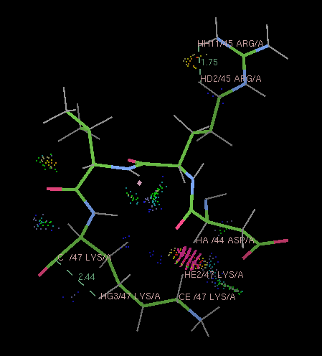
Looking at 101m_h.pbd
Clashes from clashscore:
  A 44 ASP HA A 47 LYS HE2 -0.593
Clashes from pdb_interpretation:
  HA ASP A 44 HE2 LYS A 47 -0.595
  HD2 ARG A 45 HH11 ARG A 45 -0.408
  C LYS A 47 HG3 LYS A 47 -0.467
  CD ARG A 45 HH11 ARG A 45 -0.457
  HA ASP A 44 CE LYS A 47 -0.507
After filtering:
  HA ASP A 44 HE2 LYS A 47 -0.595
  HD2 ARG A 45 HH11 ARG A 45 -0.408

Slide 27
cProfile analysis of 3e8k.pdb
Run time (in the debugger)
Calculating clash scores for 3e8k.pdb
(13596 Atoms – not including added Hydrogens)
  PROBE
    about 66 sec
  Internal
    Getting the clash score 31 sec→ 51 sec
      2.9 sec to do the vdw radius replacement and clashing pairs collection
      17.9 sec for choosing a combination of single worst clash per clashing atoms and filtering again using PDB_interpretation vdw
      Added process
      - iterating over non-bonded interaction, adjust vdw radius, collect if <0.4Å
      - sort the list of clashes and keep only the worst clash for each atom
      (overall worst clashes)
      - double filtration, once using modified vdw and once using vdw from PDB_interpretation

Slide 28
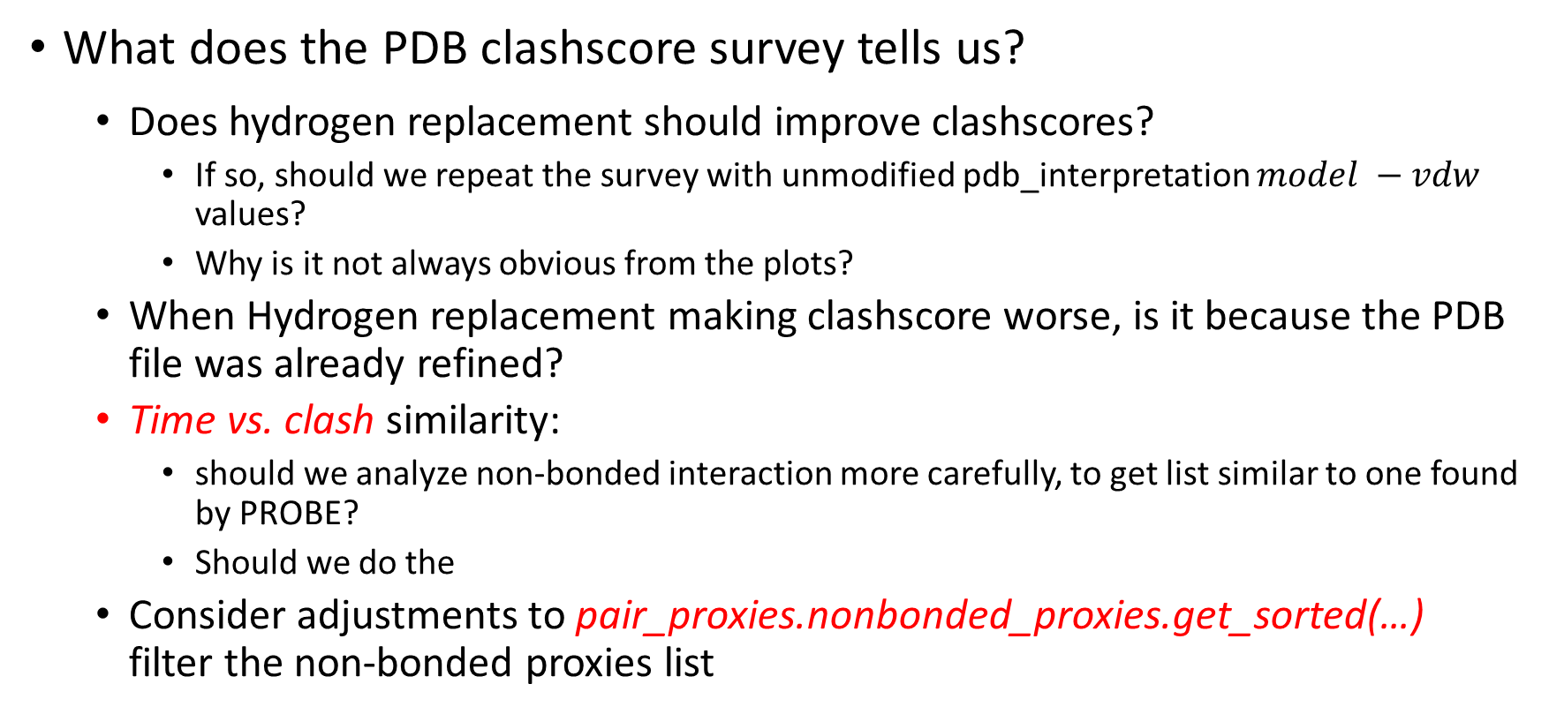
Clashscore goals revisit…
What does the PDB clashscore survey tells us?
  Does hydrogen replacement should improve clashscores?
    If so, should we repeat the survey with unmodified pdb_interpretation $model −vdw$ values?
    Why is it not always obvious from the plots?
  When Hydrogen replacement making clashscore worse, is it because the PDB file was already refined?
  Time vs. clash similarity:
    should we analyze non-bonded interaction more carefully, to get list similar to one found by PROBE?
    Should we do the
  Consider adjustments to pair_proxies.nonbonded_proxies.get_sorted(…)
  filter the non-bonded proxies list

